Slide 1




Data Analytics
Capstone Project
Adventure Works Analytics
Using
SQL & Power BI

Slide 2

Part 1:
Advanced SQL Analysis – Sales & Operations Intelligence
Part 2:
Dashboards – Power BI

Slide 3

Introduction
Adventure Works Cycles, a global leader in bicycle and accessories manufacturing, provides a rich enterprise dataset spanning sales, products, customers, and geographic markets. The objective of this project is to transform raw operational data into actionable business intelligence through the complete analytics lifecycle.

Slide 4
Project Objective
Transform Adventure Works operational data into strategic business insights that guide leadership decisions on revenue growth, product performance, customer behavior, and regional profitability—using advanced SQL for data modeling, and interactive dashboards (Power BI) for visualization, complemented by predictive analytics for future planning.

Slide 5


PHASE-1
Advanced SQL Analysis
Business Questions
1.Analyze year-over-year revenue growth and identify peak performing years.
2.Rank product categories by total sales and compare margins across categories.
3. Identify the best- and worst-selling products in terms of quantity sold and revenue generation.

Slide 6
4.Segment customers based on their total lifetime spend (e.g., low, mid, high) and determine their share of total revenue.
5.Identify top countries and regions by total sales and average order size.
6.Rank sales territories by profit margin percentage and highlight high-margin regions.
7.Calculate the return rate per category or product, and spotlight items with the highest returns.
8.Detect monthly or quarterly sales peaks and troughs—identify key seasonal patterns.
9.Determine revenue contribution from new customers versus repeat purchasers and assess changes over time.

Slide 7
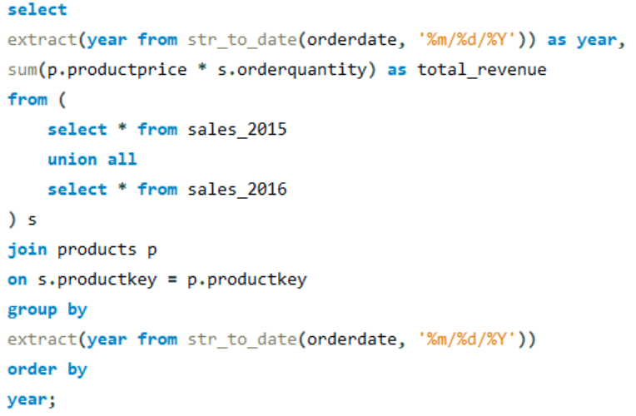
Q1.Analyze year-over-year revenue growth and identify peak performing years.
Query

Slide 8
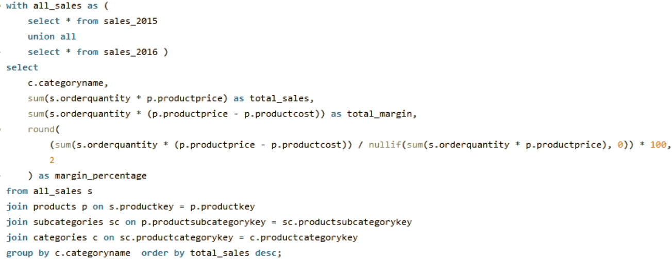
Q2.Rank product categories by total sales and compare margins across categories.
Query

Slide 9
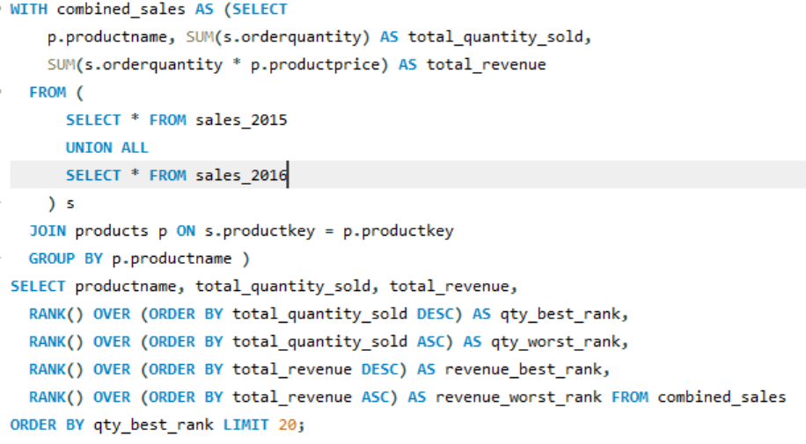
Q3.Identify the best- and worst-selling products in terms of quantity sold and revenue generation.
Query

Slide 10
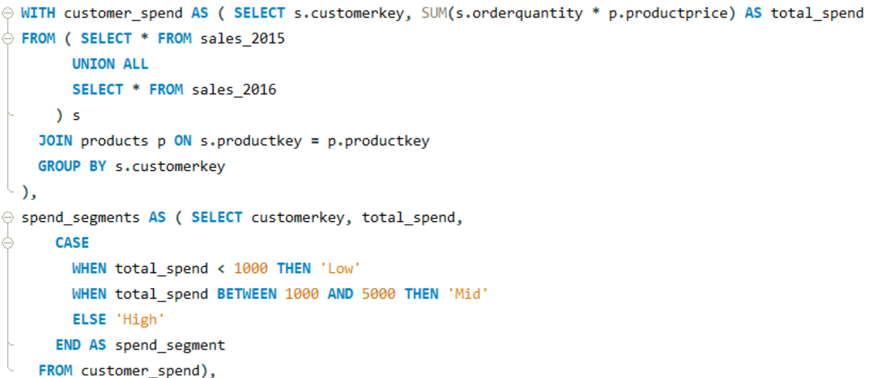
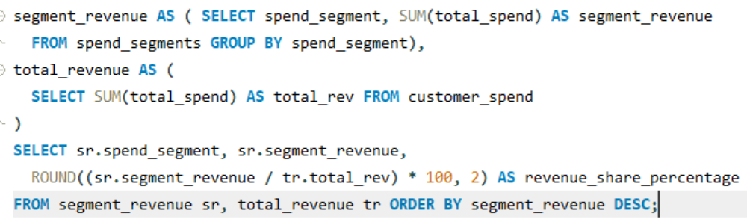
Q4.Segment customers based on their total lifetime spend (e.g., low, mid, high) and determine their share of total revenue.
Query

Slide 11
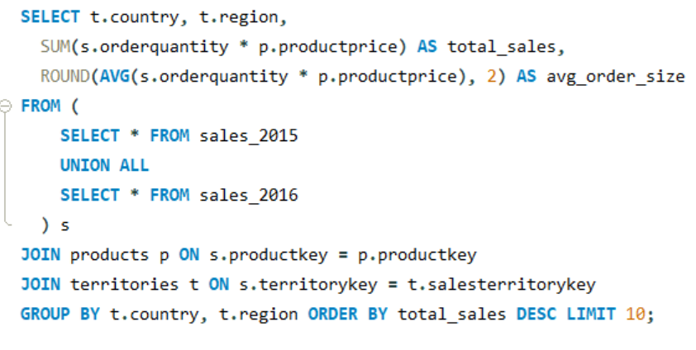
Q5.Identify top countries and regions by total sales and average order size.
Query

Slide 12
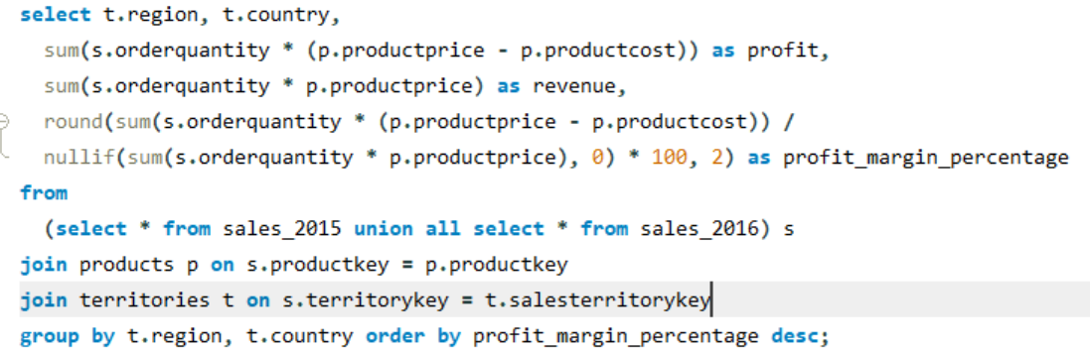
Q6.Rank sales territories by profit margin percentage and highlight high-margin regions.
Query

Slide 13
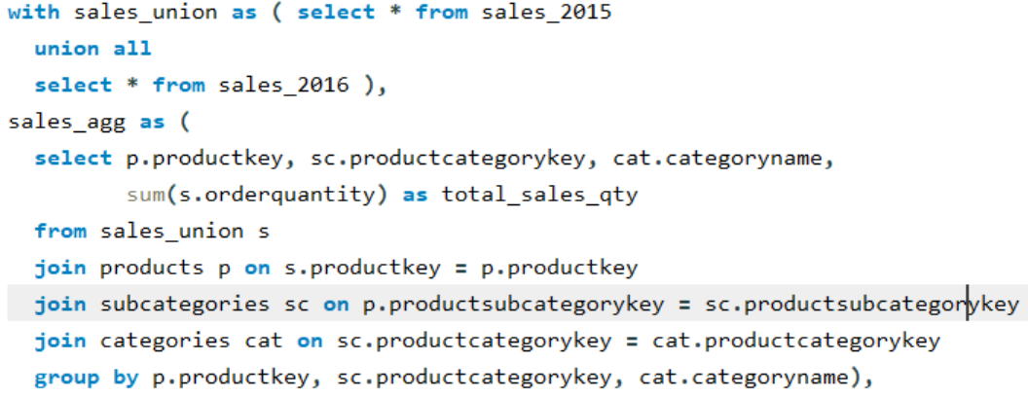
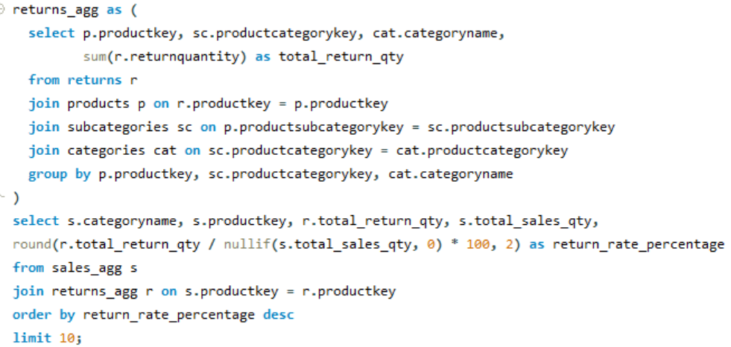
Q7.Calculate the return rate per category or product, and spotlight items with the highest returns
Query

Slide 14
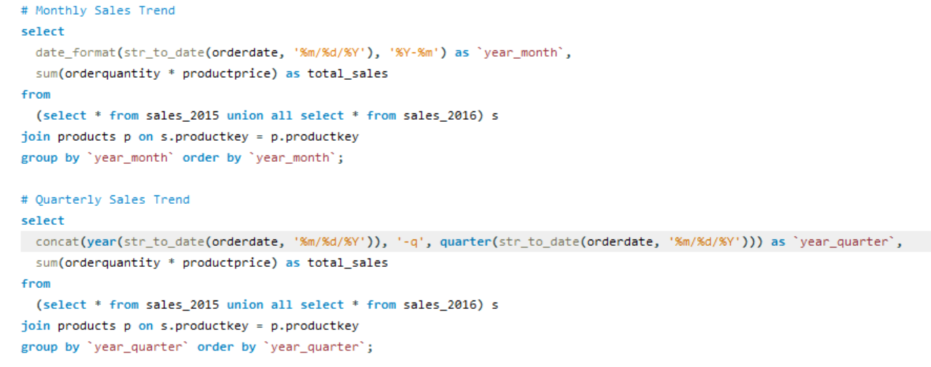
Q8.Detect monthly or quarterly sales peaks and troughs—identify key seasonal patterns.
Query

Slide 15
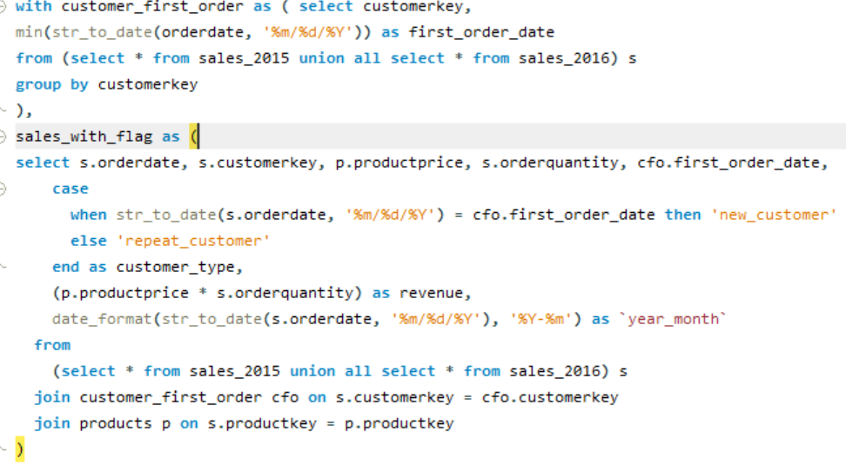
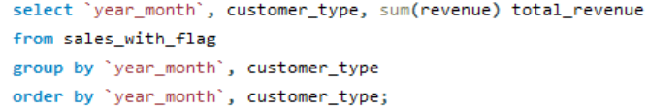
Q9.Determine revenue contribution from new customers versus repeat purchasers and assess changes over time.
Query

Slide 16
PHASE-2
Power BI
Dashboard Structure:
1. Revenue & Growth
2. Product & Category Insights
3. Customer Analytics
4. Regional Performance
5. Seasonality & Channels

Slide 17
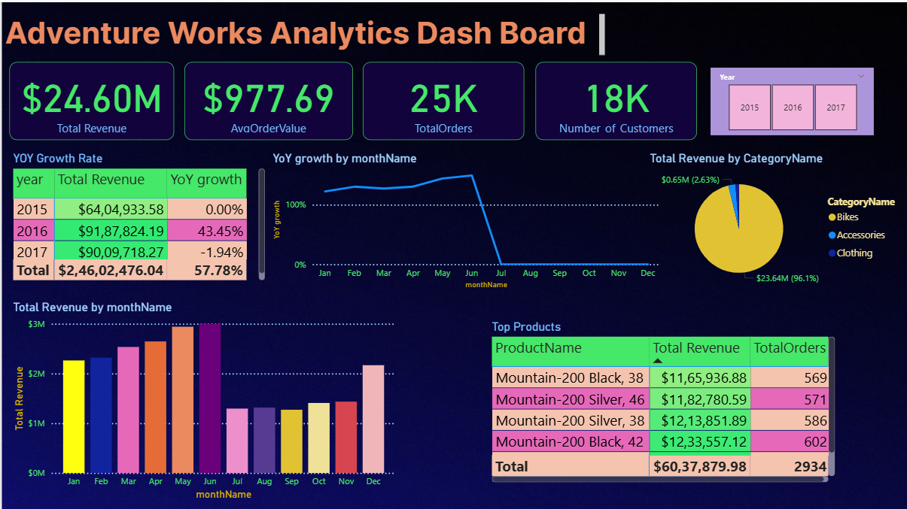
Revenue & Growth Dashboard

Slide 18
Report
📊Overall Performance:
📈Year-over-Year Growth
Total Revenue: $24.60M across the analyzed period, reflecting strong business growth.
Average Order Value: $977.69, indicating customers make high-value purchases.
Total Orders: 25K orders placed, showing a healthy sales volume.
Customers: 18K unique customers, with orders exceeding customer count — highlighting repeat purchase behavior and customer loyalty.
2015: $6.40M baseline revenue.
2016: $9.18M, showing +43.45% growth and marking 2016 as the peak growth year.
2017: $9.09M, reflecting a -1.94% decline, indicating a slight slowdown after the 2016 surge.
Overall (2015–2017): Revenue increased by 57.78% across the three years.
🔎 Insight: The business scaled rapidly in 2016, but stagnated in 2017, suggesting possible market saturation or weaker campaigns.
📅 Monthly Sales Trends
📦 Product Performance
🛒 Category Performance
Strongest months: May & June ($3M+).
Weak months: July–Oct dip significantly, suggesting seasonal impact.
🔎 Insight: Sales are highly seasonal with peaks in mid-year, possibly linked to summer campaigns/events.
Top Products: All from Mountain-200 bike series.
Revenue: ~$11M–12M each with ~570–600 orders.
🔎 Insight: Sales are overly concentrated in few SKUs, posing a dependency risk.
Bikes: Dominate with 96.1% of revenue ($23.64M).
Accessories & Clothing: Very small share (2.63% and negligible).
🔎 Insight: Heavy over-reliance on bikes; cross-selling opportunities in accessories and clothing remain untapped.

Slide 19
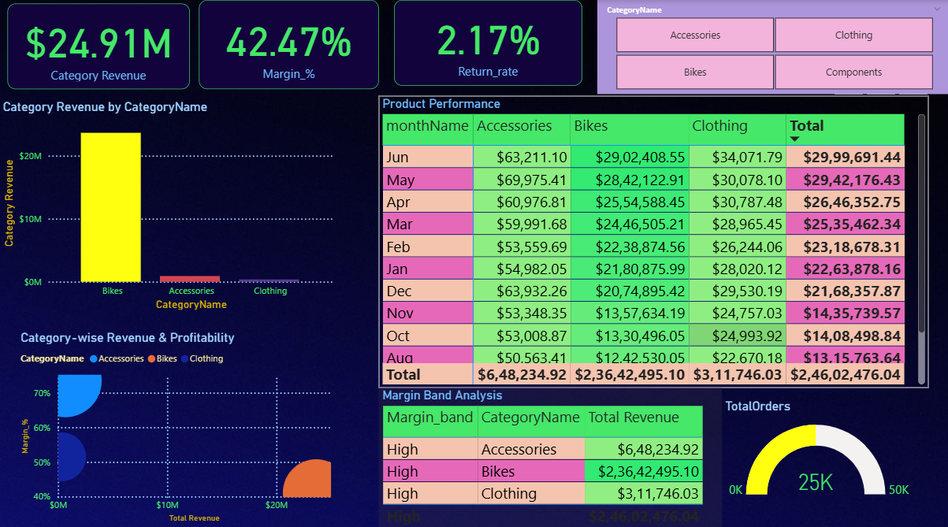
Product & Category Insights Dashboard

Slide 20
Report
📊Overall Performance:
💰 Profitability by Category
Total Revenue: $24.91M
Margin %: 42.47% → indicates strong profitability.
Return Rate: 2.17% → very low, meaning product acceptance is high.
Total Orders: 25K
🔎 Insight: The business is healthy with strong margins and very low returns, showing efficiency in both product quality and customer satisfaction.
Accessories: High margin (~70%), though small revenue.
Bikes: Largest revenue contributor with ~42% margin.
Clothing: Lowest revenue, moderate margin (~50%).
🔎 Insight: While bikes bring scale, accessories are the most profitable per dollar → strong case for upselling/cross-selling.
📦 Monthly Revenue Trends
🛒 Category Performance
Peak Months: Jun ($2.99M), May ($2.94M), Apr ($2.64M).
Lowest Month: Aug ($1.31M).
Steady Growth: Revenue stabilizes around $2M–$3M monthly after Oct.
🔎 Insight: Strong seasonal demand around Q2–Q3, with sales dip in late Q3 (Aug).
Bikes: Contribute $23.64M (96% of revenue) → dominant driver.
Accessories: $0.65M (2.6%).
Clothing: $0.31M (tiny share).
🔎 Insight: Heavy dependency on bikes, while accessories & clothing remain untapped opportunities for growth.

Slide 21
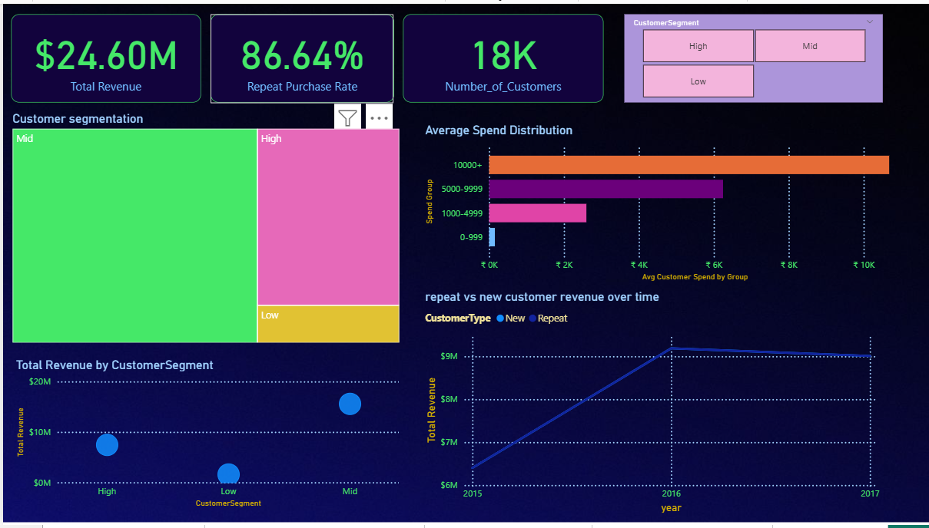
Customer Analytics Dashboard

Slide 22
Report
📊Overall Performance:
💰 Profitability by Segment
Total Revenue: $24.60M – reflects strong sales generation.
Repeat Purchase Rate: 86.64% – very high, showing strong customer loyalty and retention.
Number of Customers: 18K – sizable active customer base.
Customer Segments: Majority fall in “Mid” and “High” spend tiers, with a smaller “Low” segment
High Segment: Contributes large share of customer spend and revenue.
Mid Segment: Largest population, gives balanced revenue.
Low Segment: Small population and least contribution, opportunity for growth.
📦 Monthly Revenue Trends
🛍️ Customer Spend Distribution
Revenue Growth: Positive trend from 2015 to 2017, consistent annual increase.
Repeat vs New Revenue: Majority of revenue comes from repeat customers, with repeat revenue increasing each year.
Segment Contribution: “Mid” and “High” segments drive most year-over-year revenue.
Average Spend: Most customers in “10000+” spend category, significant premium base.
Group Trends: “5000–9999” and “1000–4999” spend groups also hold sizable shares.

Slide 23
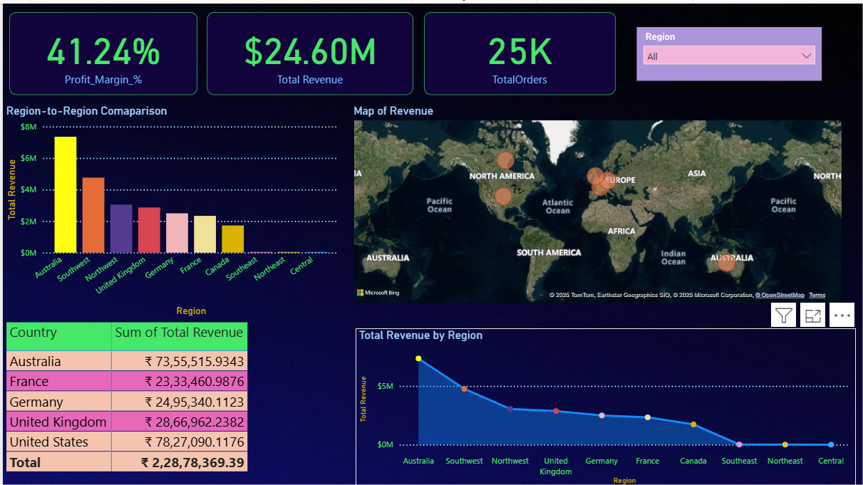
Regional Performance Dashboard

Slide 24
Report
Regional Profit & Revenue Performance
Profit Margin: Healthy at 41.24%, suggesting good cost management and pricing strategy.
Total Revenue: $24.60M with 25K orders shows solid market demand and sales volume.
Region-to-Region Revenue Comparison
Australia leads significantly with over $7M in sales — strong market presence and potential flagship region.
Southwest and Northwest U.S. regions follow with $4M–$3M in revenue, important US markets driving business.
United Kingdom, Germany, France, Canada contribute moderate but meaningful revenue ranging roughly $2M–$3M.
Southeast, Northeast, Central regions show minimal revenue, signaling opportunity areas for expansion or marketing focus.
Geographic Insights via Map & Table
Map visualization confirms revenue hotspots are in Australia, North America, and parts of Europe.
The revenue table highlights United States and Australia as top countries, making up a large share of total revenue in local currency.

Slide 25
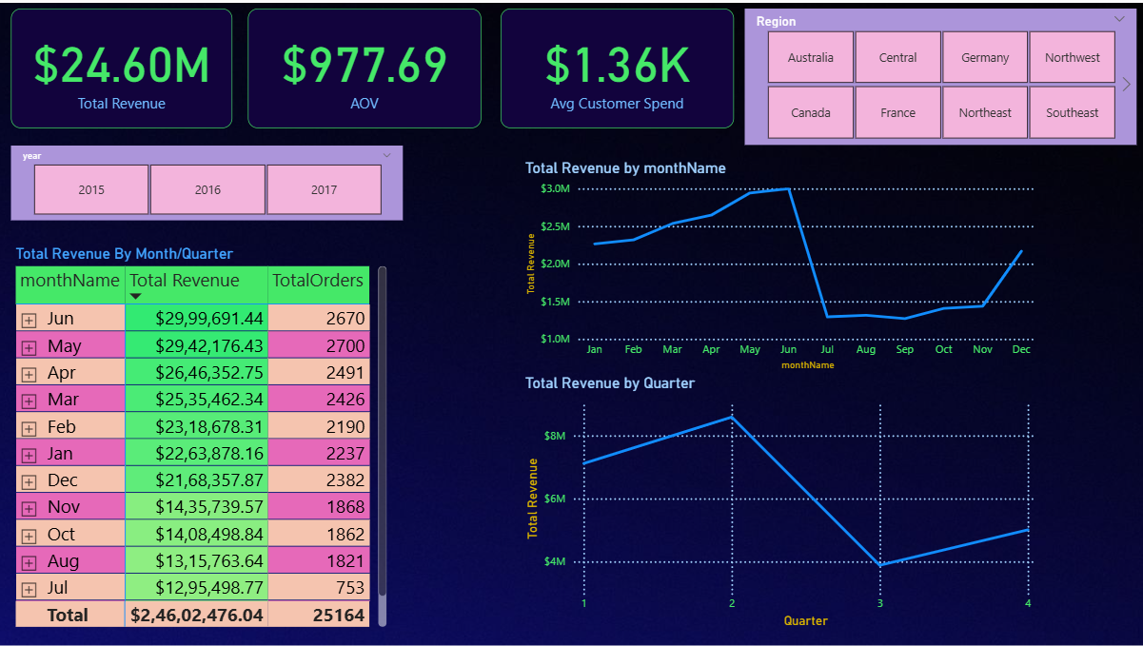
Seasonality Dashboard

Slide 26
Report
📊 Revenue and Orders Snapshot
Total Revenue: $24.60M 💰
Average Order Value (AOV): $977.69 💵
Average Customer Spend: $1.36K 🛒
📆 Monthly & Quarterly Trends
Revenue Peaks: Highest sales in May ($2.94M), June ($2.99M), and April ($2.64M), revealing strong Q2 performance.
Order Volume: Largest order counts also align with peak months, confirming seasonal demand spike.
Lowest Revenue: July and August see dips, with recovery starting in October and peaking again by December for year-end sales.
Quarter Analysis: Q2 is the strongest period ($8M+), while Q3 experiences revenue lows before Q4 recovers.
🗺️ Regional Filtering
Region Segmentation: Dashboard supports region-wise analysis (Australia, Northwest, Germany, Canada, etc.), allowing direct comparison of monthly and quarterly performance by geography.

Slide 27
Recommendations
📈 Focus on Peak Periods
🔎 Actionable Analytics Features
Target marketing and promotions around Q2 peak months (Apr–Jun) for maximum revenue gain.
Prepare inventory for high-volume months and analyze slow periods (Jul–Aug) to design recovery strategies.
Enable interactive filtering (by region, time, product, category, segment) for more granular business insights.
Add drill-down visuals for trend and anomaly investigation, letting users discover drivers of performance quickly.
🌍 Strengthen Regional Presence
📊 Visual and UX Best Practices
Double down on high-performing regions (Australia, US, Southwest).
Develop new tactics (localized campaigns, product bundling, incentives) to improve results in underperforming areas like Southeast, Northeast, and Central.
Use clear chart titles and grouping for better navigation. Prioritize most important KPIs top-left.
Maintain minimalism: remove clutter and redundant views to keep dashboards actionable and clear for decision-makers.

Slide 28

THANK YOU!!
Presented By
Navneet Narayan

